Slide 1
Chapter 5 - Naming

Slide 2
Introduction
Names play an important role to:
  share resources
  uniquely identify entities
  refer to locations
  etc.
An important issue is that a name can be resolved to the entity it refers to
to resolve names, it is necessary to implement a naming system
in a distributed system, the implementation of a naming system is itself often distributed, unlike in non distributed systems
efficiency and scalability of the naming system are the main issues

Slide 3
Objectives of the Chapter
we discuss how
  human friendly names are organized and implemented;
  e.g., those for file systems and the WWW
  names are used to locate mobile entities
  to remove names that are no more used, also called garbage collection

Slide 4
5.1 Naming Entities
Names, Identifiers, and Addresses
  a name in a distributed system is a string of bits or characters that is used to refer to an entity
  an entity is anything; e.g., resources such as hosts, printers, disks, files, objects, processes, users, ...
  entities can be operated on; e.g., a resource such as a printer offers an interface containing operations for printing a document, requesting the status of a job, ...
  to operate on an entity, it is necessary to access it through its access point, itself an entity (special)

Slide 5
  access point
    the name of an access point is called an address (such as IP address and port number as used by the transport layer)
    the address of the access point of an entity is also referred to as the address of the entity
    an entity can have more than one access point (similar to accessing an individual through different telephone numbers)
    an entity may change its access point in the course of time (e.g., a mobile computer getting a new IP address as it moves)

Slide 6
  An address is a special kind of name
    it refers to at most one entity
    each entity is referred by at most one address; even when replicated such as in Web pages
    an entity may change an access point, or an access point may be reassigned to a different entity (like telephone numbers in offices)
    separating the name of an entity and its address makes it easier and more flexible; such a name is called location independent
  There are also other types of names that uniquely identify an entity; in any case an identifier is a name with the following properties
    it refers to at most one entity
    each entity is referred by at most one identifier
    it always refers to the same entity (never reused)
  Identifiers allow us to unambiguously refer to an entity

Slide 7
  Examples
    name of an FTP server (entity)
      URL of the FTP server
    address of the FTP server
      IP number: port number
    the address of the FTP server may change

Slide 8
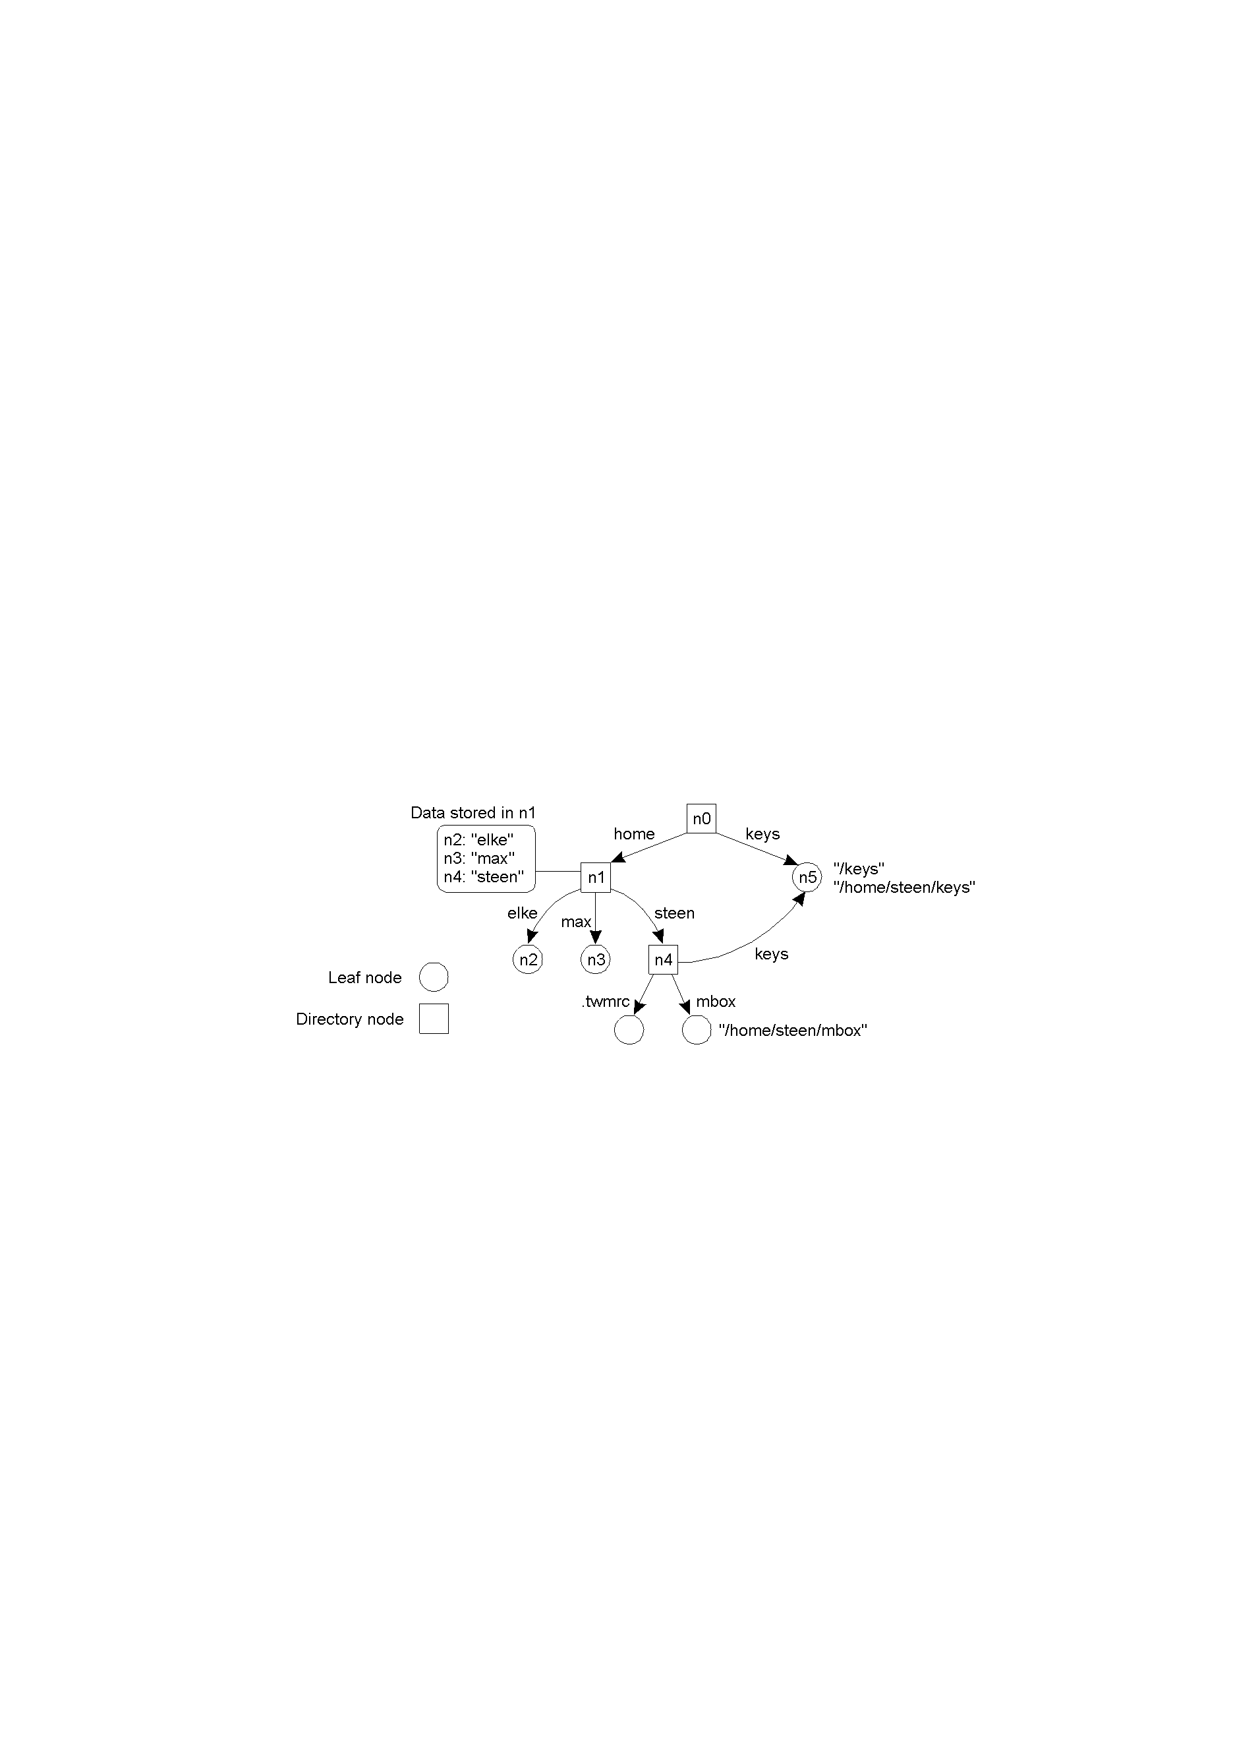
5.2 Name Spaces and Name Resolution
names in a distributed system are organized into a name space
a name space is generally organized as a labeled, directed graph with two types of nodes
  leaf node: represents the named entity and stores information such as its address or the state of that entity
  directory node: a special entity that has a number of outgoing edges, each labeled with a name
a general naming graph with a single root node

Slide 9
each node in a naming graph is considered as another entity with an identifier
a directory node stores a table in which an outgoing edge is represented as a pair (edge label, node identifier), called a directory table
each path in a naming graph can be referred to by the sequence of labels corresponding to the edges of the path and the first node in the path, such as
  N:<label1, label2, ..., labeln>, where N refers to the first node in the path
such a sequence is called a path name
if the first node is the root of the naming graph, it is called an absolute path name; otherwise it is a relative path name
instead of the path name n0:<home, steen, mbox>, we often use its string representation /home/steen/mbox
there may also be several paths leading to the same node, e.g., node n5 can be represented as /keys or /home/steen/keys

Slide 10
  although the above naming graph is directed acyclic graph (a node can have more than one incoming edge but is not permitted to have a cycle), the common way is to use a tree (hierarchical) with a single root (as is used in file systems)
    in a tree structure, each node except the root has exactly one incoming edge; the root has no incoming edges
    each node also has exactly one associated (absolute) path name

Slide 11
Name Resolution
  given a path name, the process of looking up a name stored in the node is referred to as name resolution; it consists of finding the address when the name is given (by following the path)
Linking and Mounting
  Linking: giving another name for the same entity (an alias)
    e.g., environment variables in UNIX such as HOME that refer to the home directory of a user
    two types of links (or two ways to implement an alias):
      hard link: to allow multiple absolute path names to refer to the same node in a naming graph
        e.g., in the previous graph, there are two different path names for node n5: /keys and /home/steen/keys

Slide 12
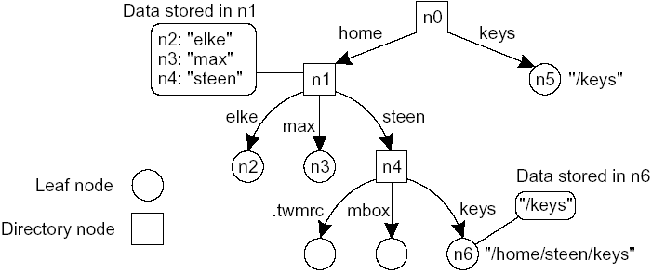
  symbolic link: representing an entity by a leaf node and instead of storing the address or state of the entity, the node stores an absolute path name
the concept of a symbolic link explained in a naming graph
when first resolving an absolute path name stored in a node (e.g., /home/steen/keys in node n6), name resolution will return the path name stored in the node (/keys), at which point it can continue with resolving that new path name

Slide 13
  so far name resolution was discussed as taking place within a single name space
  name resolution can also be used to merge different name spaces in a transparent way
  two methods: mounting and adding a new root node and making the existing root nodes its children
  1. Mounting
as an example, consider a mounted file system, which can be generalized to other name spaces as well
let a directory node store the directory node from a different (foreign) name space
the directory node storing the node identifier is called a mount point
the directory node in the foreign name space is called a mounting point, normally the root of a name space
during name resolution, the mounting point is looked up and resolution proceeds by accessing its directory table

Slide 14
consider a collection of name spaces distributed across different machines (each name space implemented by a different server)
to mount a foreign name space in a DS, the following are at least required
  the name of an access protocol (for communication)
  the name of the server
  the name of the mounting point
each of these names needs to be resolved
  to the implementation of the protocol
  to an address where the server can be reached
  to a node identifier in the foreign name space
the three names can be listed as a URL

Slide 15
example: Sun’s Network File System (NFS) is a distributed file system with a protocol that describes how a client can access a file stored on a (remote) NFS file server
  an NFS URL may look like nfs://flits.cs.vu.nl/home/steen
    - nfs is an implementation of a protocol
    - flits.cs.vu.nl is a server name to be resolved using DNS
    - /home/steen is resolved by the server
  e.g., the subdirectory /remote includes mount points for foreign name spaces on the client machine
    a directory node named /remote/vu is used to store nfs://flits.cs.vu.nl/home/steen
    consider /remote/vu/mbox
    this name is resolved by starting at the root directory on the client’s machine until node /remote/vu, which returns the URL nfs://flits.cs.vu.nl/home/steen
    this leads the client machine to contact flits.cs.vu.nl using the NFS protocol
    then the file mbox is read in the directory /home/steen

Slide 16
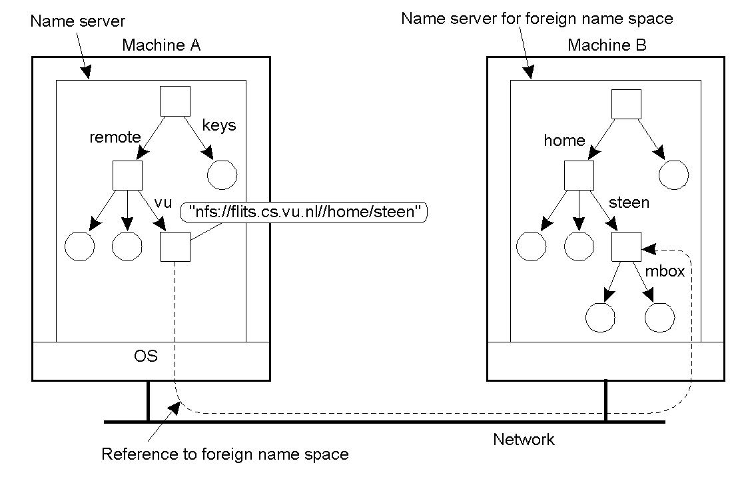
mounting remote name spaces through a specific process protocol

Slide 17
    distributed systems that allow mounting a remote file system also allow to execute some commands
    example commands to access the file system
        cd /remote/vu
        ls -l
    by doing so the user is not supposed to worry about the details of the actual access; the name space on the local machine and that on the remote machine look to form a single name space

Slide 18
2. Add a new root node and make the existing root nodes its children
  a method followed in GNS (Global Name Service by DEC)
  problem: existing names need to be changed
  e.g., the absolute path name /home/steen has now changed to a relative path name and corresponds to the absolute path name /vu/home/steen
  hence the system must expand no:/home/steen to /vu/home/steen without the awareness of users
  this requires storing a mapping table (with entries such as n0→vu) when a new root node is added
  merging thousands of name spaces may lead to performance problems

Slide 19
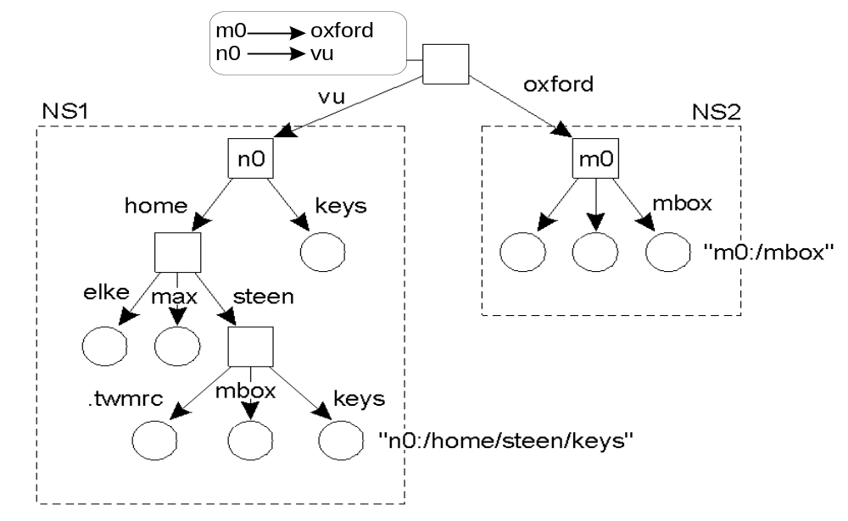
organization of the DEC Global Name Service

Slide 20
The Implementation of a Name Space
  a name space forms the heart of a naming service
  a naming service allows users and processes to add, remove, and lookup names
  a naming service is implemented by name servers
  for a distributed system on a single LAN, a single server might suffice; for a large-scale distributed system the implementation of a name space is distributed over multiple name servers
Name Space Distribution
  in large scale distributed systems, it is necessary to distribute the name service over multiple name servers, usually organized hierarchically
  a name service can be partitioned into logical layers
  the following three layers can be distinguished (Cheriton and Mann)

Slide 21
  Global layer
    formed by highest level nodes (root node and nodes close to it or its children)
    nodes on this layer are characterized by their stability, i.e., directory tables are rarely changed
    they may represent organizations, groups of organizations, ..., where names are stored in the name space
  Administrational layer
    groups of entities that belong to the same organization or administrational unit, e.g., departments
    relatively stable
  Managerial layer
    nodes that may change regularly, e.g., nodes representing hosts of a LAN, shared files such as libraries or binaries, …
    nodes are managed not only by system administrators, but also by end users

Slide 22
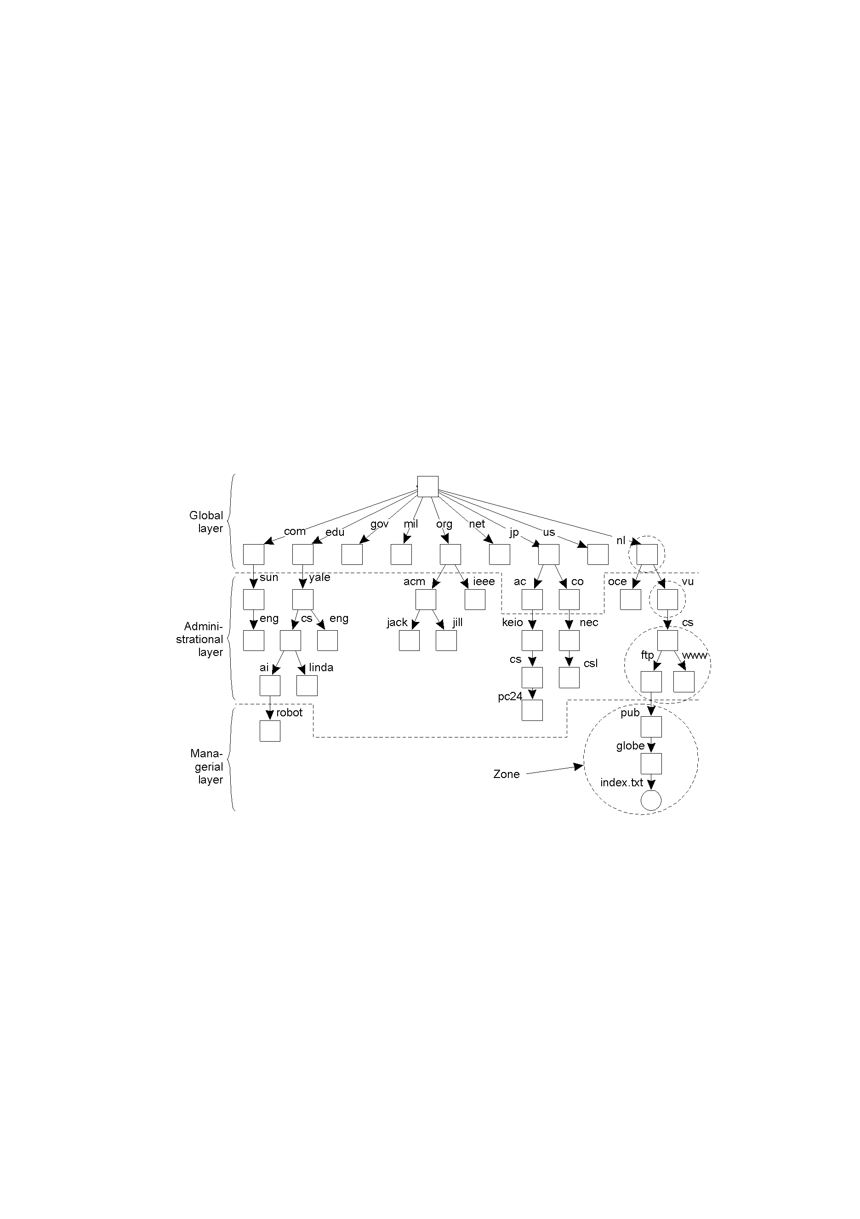
an example partitioning of the DNS name space, including Internet-accessible files, into three layers

Slide 23
the name space is divided into nonoverlapping parts, called zones in DNS
a zone is a part of the name space that is implemented by a separate name server
some requirements of servers at different layers
  performance (responsiveness to lookups), availability (failure rate), etc.
  high availability is critical for the global layer, since name resolution cannot proceed beyond the failing server; it is also important at the administrational layer for clients in the same organization
  performance is very important in the lowest layer, since results of lookups can be cached and used due to the relative stability of the higher layers
  they may be enhanced by client side caching (global and administrational layers since names do not change often) and replication; they create implementation problems since they may introduce inconsistency problems (see Chapter 5)

Slide 24
Implementation of Name Resolution
  recall that name resolution consists of finding the address when the name is given
  assume that name servers are not replicated and that no client-side caches are allowed
  each client has access to a local name resolver, responsible for ensuring that the name resolution process is carried out
  e.g., assume the path name
      root:<nl, vu, cs, ftp, pub, globe, index.txt>
      is to be resolved
      or using a URL notation, this path name would correspond to ftp://ftp.cs.vu.nl/pub/globe/index.txt
  two ways of implementing name resolution
    iterative name resolution
    recursive name resolution

Slide 25
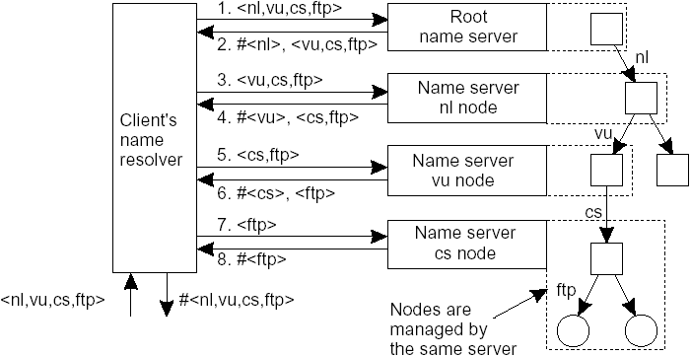
Iterative
  a name resolver hands over the complete name to the root name server
  the root server will resolve the name as far as it can and return the result to the client; at the minimum it can resolve the first level and sends the name of the first level name server to the client
  the client calls the first level name server, then the second, ..., until it finds the address of the entity
the principle of iterative name resolution

Slide 26
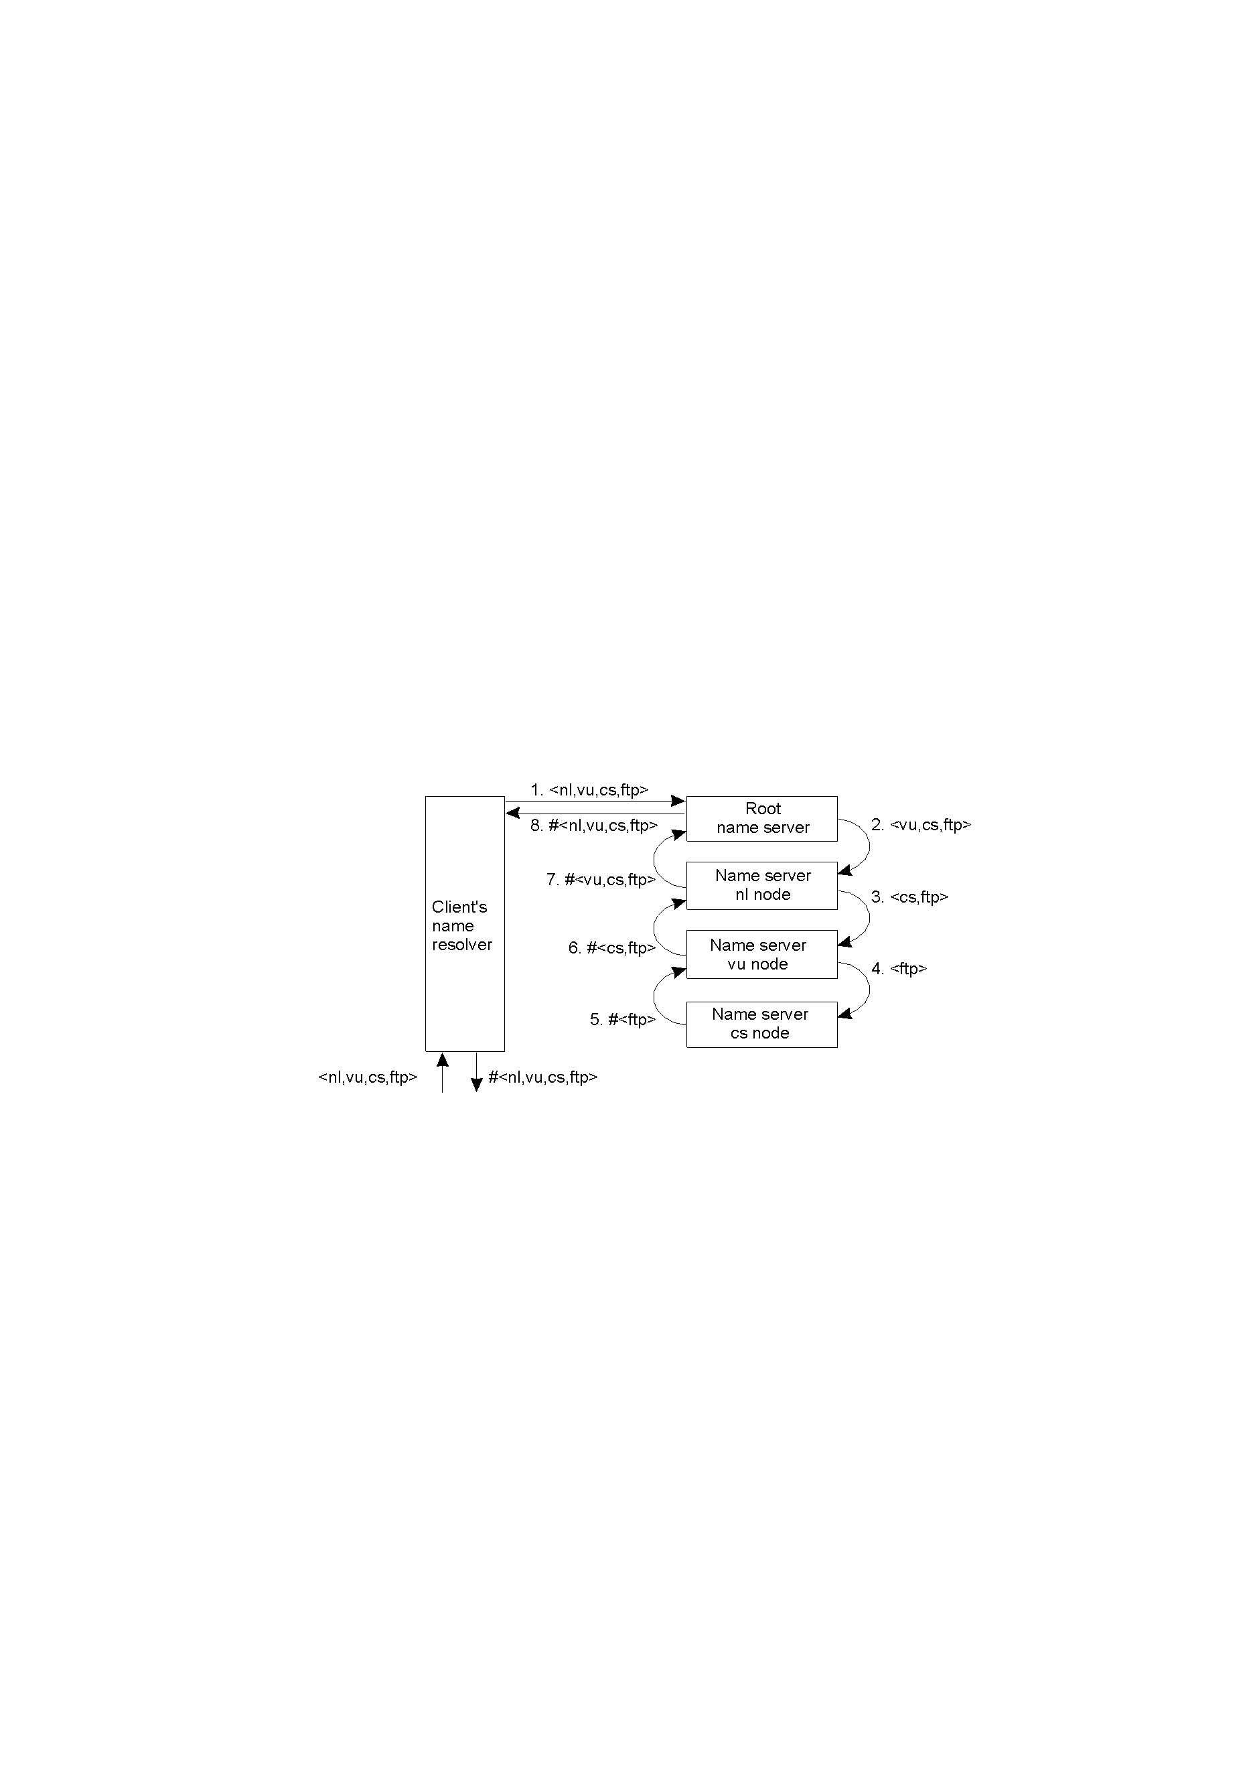
Recursive
  a name resolver hands over the whole name to the root name server
  the root server will try to resolve the name and if it can’t, it requests the first level name server to resolve it and to return the address
  the first level will do the same thing recursively
the principle of recursive name resolution

Slide 27
Advantages and drawbacks
  recursive name resolution puts a higher performance demand on each name server; hence name servers in the global layer support only iterative name resolution
  caching is more effective with recursive name resolution; each name server gradually learns the address of each name server responsible for implementing lower-level nodes; eventually lookup operations can be handled efficiently
Server for node | Should resolve | Looks up | Passes to child | Receives and caches | Returns to requester
cs | <ftp> | #<ftp> | -- | -- | #<ftp>
vu | <cs,ftp> | #<cs> | <ftp> | #<ftp> | #<cs> #<cs, ftp>
nl | <vu,cs,ftp> | #<vu> | <cs,ftp> | #<cs> #<cs,ftp> | #<vu> #<vu,cs> #<vu,cs,ftp>
root | <nl,vu,cs,ftp> | #<nl> | <vu,cs,ftp> | #<vu> #<vu,cs> #<vu,cs,ftp> | #<nl> #<nl,vu> #<nl,vu,cs> #<nl,vu,cs,ftp>
recursive name resolution of <nl, vu, cs, ftp>; name servers cache intermediate results for subsequent lookups

Slide 28
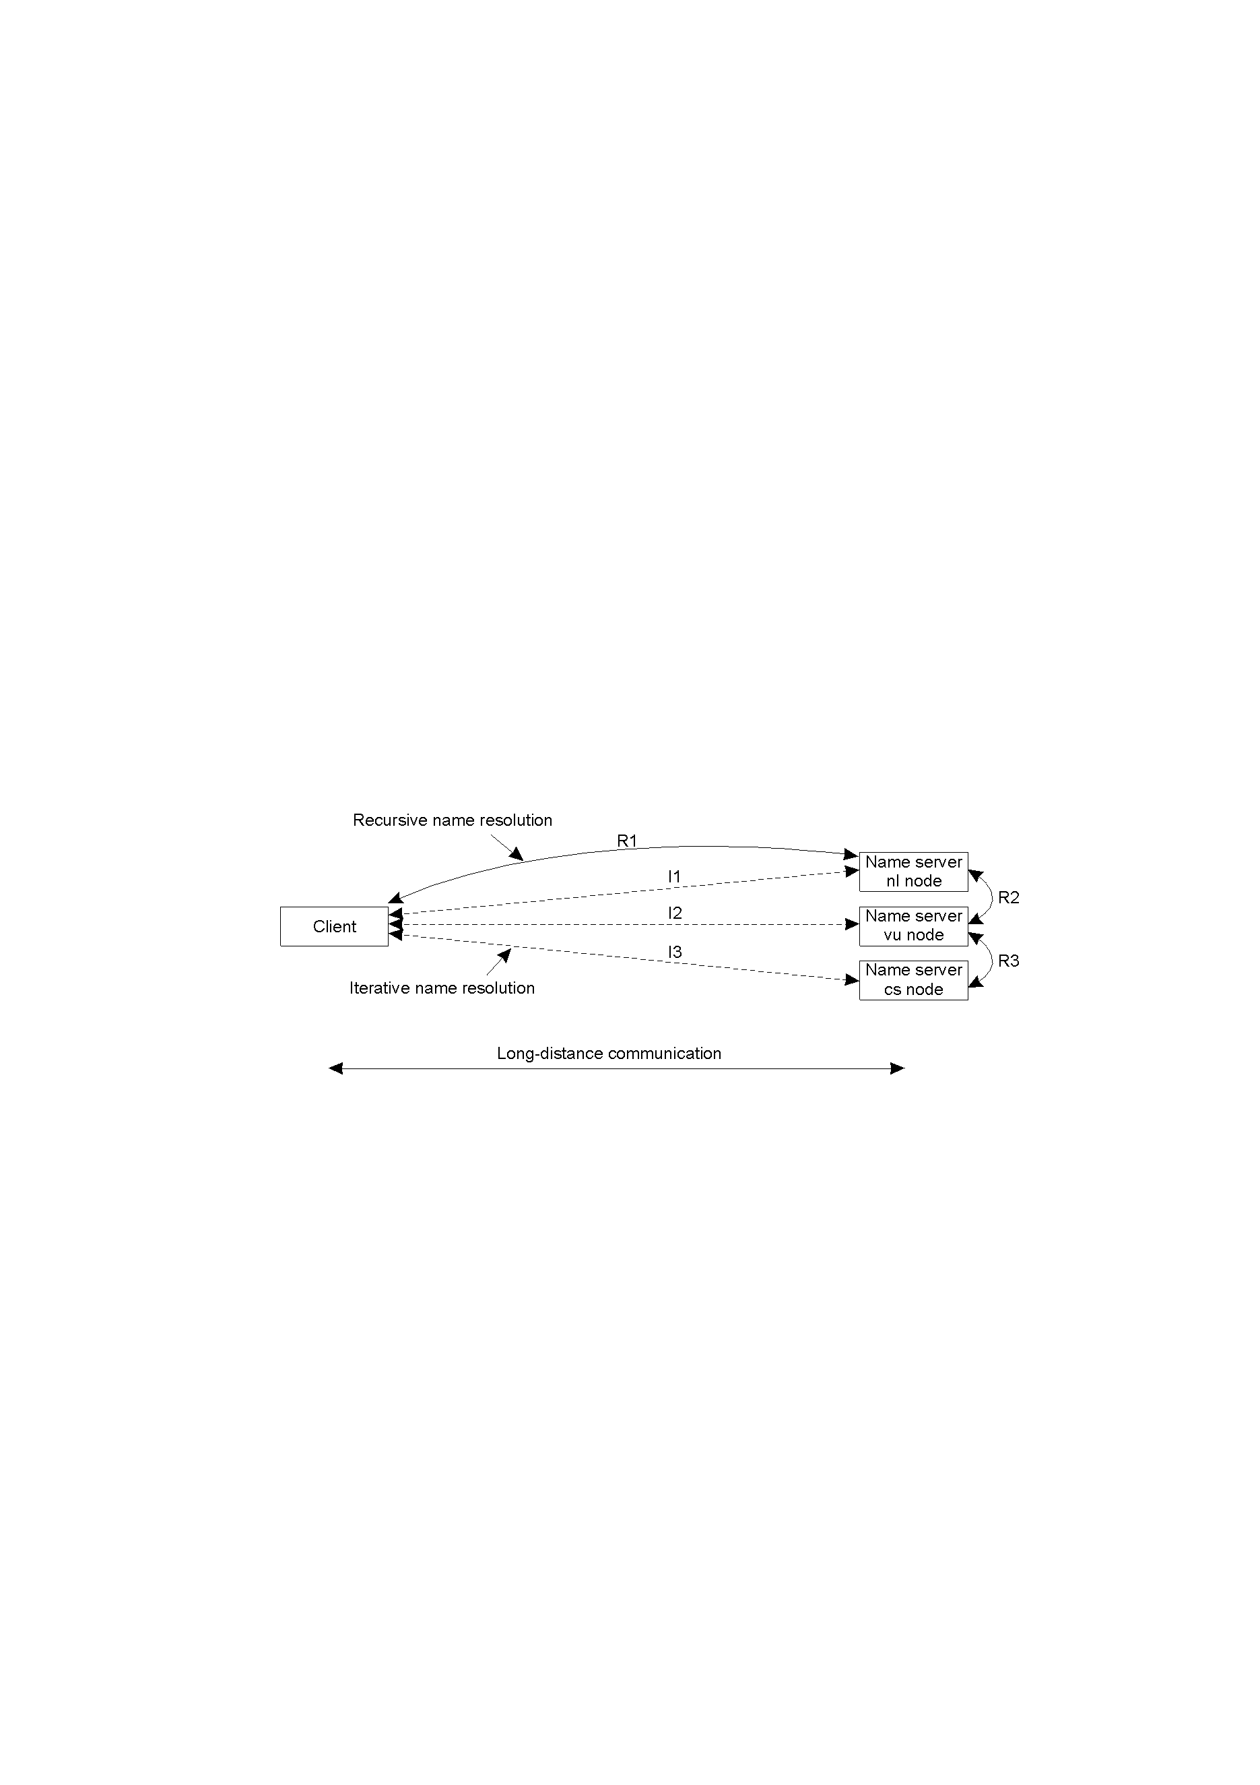
  communication costs may be reduced in recursive name resolution
the comparison between recursive and iterative name resolution with respect to communication costs; assume the client is in Ethiopia and the name servers in the Netherlands
Summary
Method | Advantage(s)
Recursive | Less Communication cost; Caching is more effective
Iterative | Less performance demand on name servers

Slide 29
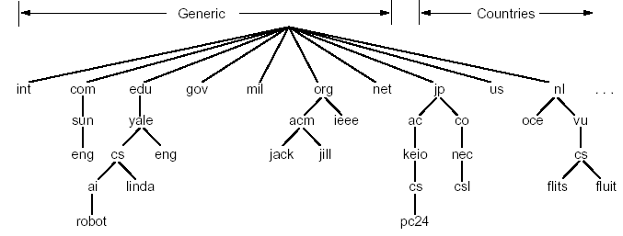
Example 1 - The Domain Name System (DNS)
  one of the largest distributed naming services is the Internet DNS
  it is used for looking up host addresses and mail servers
  hierarchical, defined in an inverted tree structure with the root at the top
  the tree can have only 128 levels

Slide 30
Thank you!
?

